Slide 1
DWDM
Unit 4

Slide 2
Multidimensional Data Model
From Tables and Spreadsheets to Data Cubes
A data cube allows data to be modeled and viewed in multiple dimensions.
It is defined by dimensions and facts.
Dimensions are the entities with respect to which an organization wants to keep records.
For example, an organization may create a sales data warehouse in order to keep records of the store’s sales with respect to the dimensions time, item, branch, and location.
Each dimension may have a table associated with it, called a dimension table. This table further describes the dimensions. For example, a dimension table for item may contain the attributes item name, brand, and type.

Slide 3
Multidimensional Data Model…
From Tables and Spreadsheets to Data Cubes
A multidimensional data model is typically organized around a central theme, like sales. This theme is represented by a fact table.
Facts are numerical measures. Themes are the quantities by which we want to analyze relationships between dimensions.
Examples of facts for a sales data warehouse include dollars_sold (sales amount in dollars), units_sold (number of units sold), and amount budgeted.
The fact table contains the names of the facts, or measures, as well as keys to each of the related dimension tables.

Slide 4
Multidimensional Data Model…
Figure: Sales data for an organization according to the dimensions time, item, and location. The measure displayed is dollars_sold.

Slide 5
Multidimensional Data Model…
Figure A 3-D data cube representation of the data in above table, according to the dimensions time, item, and location. The measure displayed is dollars_sold (in thousands).

Slide 6
Multidimensional Data Model…
Suppose that we would now like to view our sales data with an additional fourth dimension, such as supplier. Viewing things in 4-D becomes tricky. However, we can think of a 4-D cube as being a series of 3-D cubes, as shown in Figure below.
If we continue in this way, we may display any n-dimensional data as a series of
(n-1) dimensional cubes. The data cube is a metaphor for multidimensional data storage. The actual physical storage of such data may differ from its logical representation. The important thing to remember is that data cubes are
n-dimensional and do not confine data to 3-D.

Slide 7
Multidimensional Data Model…
Figure 4-D data cube representation of sales data, according to the dimensions time, item, location, and supplier. The measure displayed is dollars_sold (in thousands)

Slide 8
Multidimensional Data Model…
A data warehouse is based on a multidimensional data model which views data in the form of a data cube
A data cube, such as sales, allows data to be modeled and viewed in multiple dimensions
Dimension tables, such as item (item_name, brand, type), or time(day, week, month, quarter, year)
Fact table contains measures (such as dollars_sold) and keys to each of the related dimension tables
In data warehousing literature, an n-D base cube is called a base cuboid. The top most 0-D cuboid, which holds the highest-level of summarization, is called the apex cuboid. The lattice of cuboids forms a data cube.

Slide 9
Multidimensional Data Model…
all
0-D(apex) cuboid
time
item
location
supplier
1-D cuboids
time,location
item,location
location,supplier
2-D cuboids
time,supplier
item,supplier
time, item
time,location,supplier
3-D cuboids
time,item, location
time,item,supplier
item,location,supplier
4-D(base) cuboid
time, item, location, supplier
Figure: Cube; A Lattice of Cuboids

Slide 10
A Concept Hierarchy: Dimension (location)
all
all
region
Europe
...
North_America
Germany
country
...
Spain
Canada
...
Mexico
Vancouver
city
Frankfurt
...
...
Toronto
office
L. Chan
...
M. Wind

Slide 11
Online Analytical Processing (OLAP)
Online Analytical Processing Server (OLAP) is based on the multidimensional data model.
It allows managers, and analysts to get an insight of the information through fast, consistent, and interactive access to information.

Slide 12
OLAP Operations
Since OLAP servers are based on multidimensional view of data, we will discuss OLAP operations in multidimensional data.
Here is the list of OLAP operations:
Roll-up
Drill-down
Slice and dice
Pivot (rotate)

Slide 13
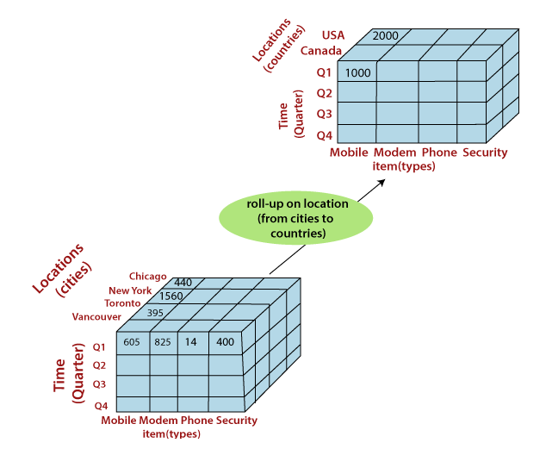
OLAP Operations
Figure: Roll up from City to Countries

Slide 14
OLAP Operations
Roll-up
Roll-up performs aggregation on a data cube in any of the following ways:
By climbing up a concept hierarchy for a dimension or by dimension reduction. The following diagram illustrates how roll-up works.
Roll-up is performed by climbing up a concept hierarchy for the dimension location.
Initially the concept hierarchy was "street < city < province < country". On rolling up, the data is aggregated by ascending the location hierarchy from the level of city to the level of country. The data is grouped into cities rather than countries.
When roll-up is performed, one or more dimensions from the data cube are removed.

Slide 15
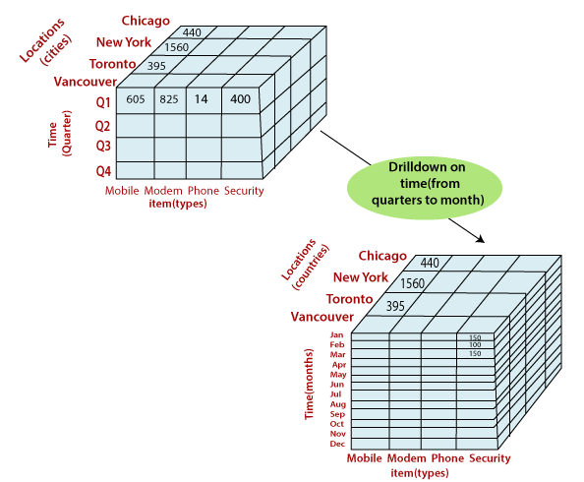
OLAP Operations
Figure: Drill down from Quarterly to months

Slide 16
OLAP Operations
Drill-down
Drill-down is the reverse operation of roll-up.
It is performed by either of the following ways:
By stepping down a concept hierarchy for a dimension or by introducing a new dimension
Drill-down is performed by stepping down a concept hierarchy for the dimension time. Initially the concept hierarchy was "day < month < quarter < year.“
On drilling down, the time dimension is descended from the level of quarter to the level of month.
When drill-down is performed, one or more dimensions from the data cube are added.
It navigates the data from less detailed data to highly detailed data.

Slide 17
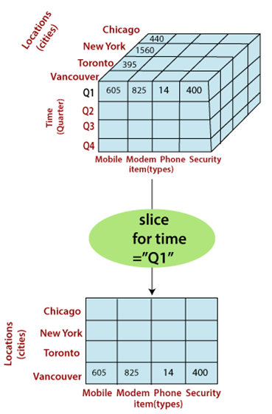
OLAP Operations
Slice
The slice operation selects one particular dimension from a given cube and provides a new sub-cube.
Consider the following diagram that shows how slice works.
Here Slice is performed for the dimension "time" using the criterion time = "Q1". It will form a new sub-cube by selecting one
Figure: Performing slice operation

Slide 18
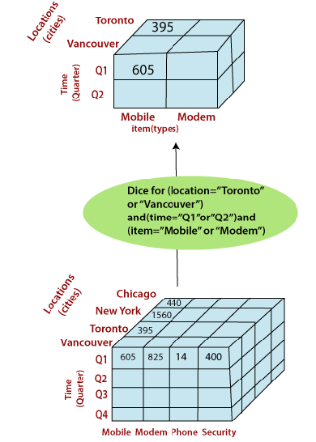
OLAP Operations
Dice
Dice selects two or more dimensions from a given cube and provides a new sub-cube.
Consider the following diagram that shows the dice operation.
The dice operation on the cube based on the following selection criteria involves three dimensions.
(location = "Toronto" or "Vancouver")
(time = "Q1" or "Q2")
(item =" Mobile" or "Modem")
Figure: Performing dice operation

Slide 19
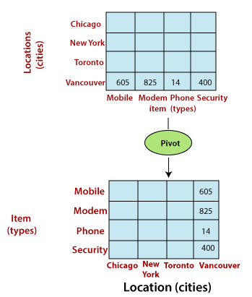
OLAP Operations
Pivot
The pivot operation is also called a rotation.
Pivot is a visualization operations which rotates the data axes in view to provide an alternative presentation of the data.
It may contain swapping the rows and columns or moving one of the row-dimensions into the column dimensions.
Figure: Performing pivot operation

Slide 20
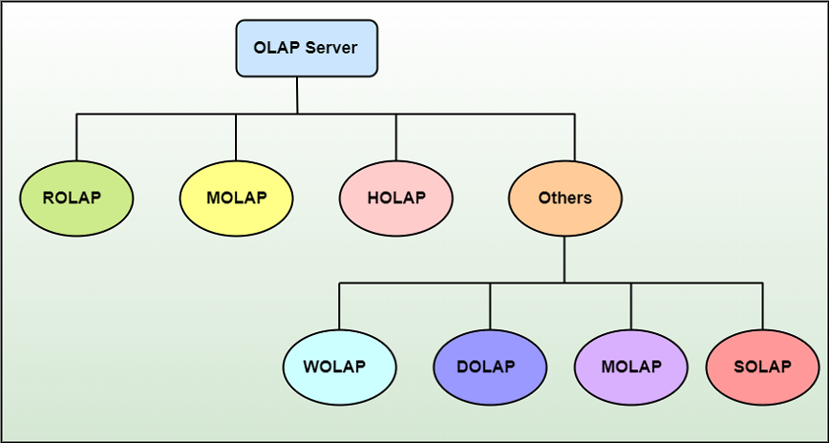
Types of OLAP Servers

Slide 21
Types of OLAP Servers…
We have basically three types of OLAP servers
ROLAP stands for Relational OLAP, an application based on relational DBMSs.
MOLAP stands for Multidimensional OLAP, an application based on multidimensional DBMSs.
HOLAP stands for Hybrid OLAP, an application using both relational and multidimensional techniques.

Slide 22
Types of OLAP Servers…
Relational OLAP
Relational OLAP servers are placed between relational back-end server and client front-end tools. To store and manage the warehouse data, the relational OLAP uses relational or extended-relational DBMS. ROLAP includes the following:
Implementation of aggregation navigation logic
Optimization for each DBMS back-end
Additional tools and services

Slide 23
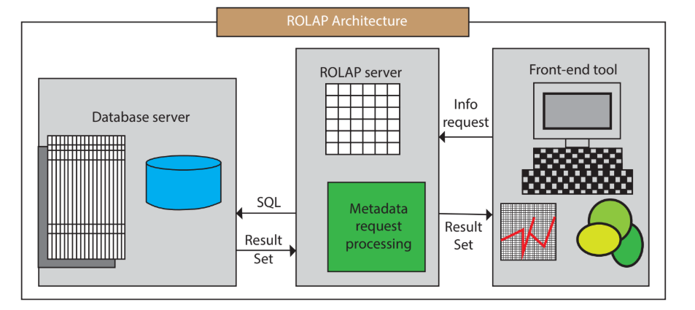
Types of OLAP Servers…

Slide 24
Types of OLAP Servers…
These are intermediate servers which stand in between a relational back-end server and user frontend tools.
They use a relational or extended-relational DBMS to save and handle warehouse data, and OLAP middleware to provide missing pieces.
ROLAP servers contain optimization for each DBMS back end, implementation of aggregation navigation logic, and additional tools and services.
ROLAP technology tends to have higher scalability than MOLAP technology.
ROLAP systems work primarily from the data that resides in a relational database, where the base data and dimension tables are stored as relational tables. This model permits the multidimensional analysis of data.

Slide 25
Types of OLAP Servers…
This technique relies on manipulating the data stored in the relational database to give the presence of traditional OLAP's slicing and dicing functionality. In essence, each method of slicing and dicing is equivalent to adding a "WHERE" clause in the SQL statement.
ROLAP Architecture includes the following components
Database server.
ROLAP server.
Front-end tool.

Slide 26
Types of OLAP Servers…
ROLAP is the latest and fastest-growing OLAP technology segment in the market. This method allows multiple multidimensional views of two-dimensional relational tables to be created, avoiding structuring record around the desired view.
Some products in this segment have supported reliable SQL engines to help the complexity of multidimensional analysis. This includes creating multiple SQL statements to handle user requests, being 'RDBMS' aware and also being capable of generating the SQL statements based on the optimizer of the DBMS engine.

Slide 27
Types of OLAP Servers…
Advantages
Can handle large amounts of information: The data size limitation of ROLAP technology is depends on the data size of the underlying RDBMS. So, ROLAP itself does not restrict the data amount.
<="" strong="">RDBMS already comes with a lot of features. So ROLAP technologies, (works on top of the RDBMS) can control these functionalities.
Disadvantages
Performance can be slow: Each ROLAP report is a SQL query (or multiple SQL queries) in the relational database, the query time can be prolonged if the underlying data size is large.
Limited by SQL functionalities: ROLAP technology relies on upon developing SQL statements to query the relational database, and SQL statements do not suit all needs.
round the desired view.

Slide 28
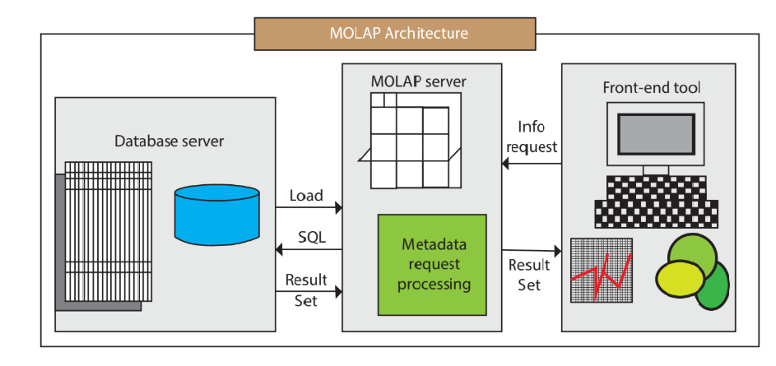
Types of OLAP Servers…

Slide 29
Types of OLAP Servers…
A MOLAP system is based on a native logical model that directly supports multidimensional data and operations. Data are stored physically into multidimensional arrays, and positional techniques are used to access them.
One of the significant distinctions of MOLAP against a ROLAP is that data are summarized and are stored in an optimized format in a multidimensional cube, instead of in a relational database. In MOLAP model, data are structured into proprietary formats by client's reporting requirements with the calculations pre-generated on the cubes.

Slide 30
Types of OLAP Servers…
MOLAP Architecture includes the following components
Database server
MOLAP server
Front-end tool

Slide 31
Types of OLAP Servers…
MOLAP structure primarily reads the precompiled data. MOLAP structure has limited capabilities to dynamically create aggregations or to evaluate results which have not been pre-calculated and stored.
Applications requiring iterative and comprehensive time-series analysis of trends are well suited for MOLAP technology (e.g., financial analysis and budgeting).
Examples include Arbor Software's Essbase. Oracle's Express Server, Pilot Software's Lightship Server, Sniper's TM/1. Planning Science's Gentium and Kenan Technology's Multiway.
Some of the problems faced by clients are related to maintaining support to multiple subject areas in an RDBMS. Some vendors can solve these problems by continuing access from MOLAP tools to detailed data in and RDBMS.

Slide 32
Types of OLAP Servers…
This can be very useful for organizations with performance-sensitive multidimensional analysis requirements and that have built or are in the process of building a data warehouse architecture that contains multiple subject areas.
An example would be the creation of sales data measured by several dimensions (e.g., product and sales region) to be stored and maintained in a persistent structure.
This structure would be provided to reduce the application overhead of performing calculations and building aggregation during initialization. These structures can be automatically refreshed at predetermined intervals established by an administrator.

Slide 33
Types of OLAP Servers…
Advantages
Excellent Performance: A MOLAP cube is built for fast information retrieval, and is optimal for slicing and dicing operations.
Can perform complex calculations: All evaluation have been pre-generated when the cube is created. Hence, complex calculations are not only possible, but they return quickly.

Slide 34
Types of OLAP Servers…
Disadvantages
Limited in the amount of information it can handle: Because all calculations are performed when the cube is built, it is not possible to contain a large amount of data in the cube itself.
Requires additional investment: Cube technology is generally proprietary and does not already exist in the organization. Therefore, to adopt MOLAP technology, chances are other investments in human and capital resources are needed.

Slide 35
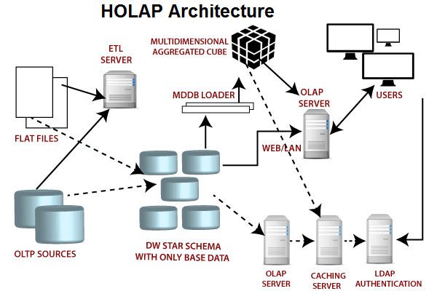
Types of OLAP Servers…

Slide 36
Types of OLAP Servers…
Hybrid OLAP (HOLAP) Server
HOLAP incorporates the best features of MOLAP and ROLAP into a single architecture. HOLAP systems save more substantial quantities of detailed data in the relational tables while the aggregations are stored in the pre-calculated cubes.
HOLAP also can drill through from the cube down to the relational tables for delineated data. The Microsoft SQL Server 2000 provides a hybrid OLAP server.

Slide 37
Types of OLAP Servers…
Advantages of HOLAP
HOLAP provide benefits of both MOLAP and ROLAP.
It provides fast access at all levels of aggregation.
HOLAP balances the disk space requirement, as it only stores the aggregate information
on the OLAP server and the detail record remains in the relational database.
So no duplicate copy of the detail record is maintained.
Disadvantages of HOLAP
HOLAP architecture is very complicated because it supports both MOLAP and ROLAP servers.

Slide 38
Types of OLAP Servers…
Web-Enabled OLAP (WOLAP) Server
WOLAP pertains to OLAP application which is accessible via the web browser. Unlike traditional client/server OLAP applications, WOLAP is considered to have a three-tiered architecture which consists of three components: a client, a middleware, and a database server.
Desktop OLAP (DOLAP) Server
DOLAP permits a user to download a section of the data from the database or source, and work with that dataset locally, or on their desktop.

Slide 39
Types of OLAP Servers…
Mobile OLAP (MOLAP) Server
Mobile OLAP enables users to access and work on OLAP data and applications remotely through the use of their mobile devices.
Spatial OLAP (SOLAP) Server
SOLAP includes the capabilities of both Geographic Information Systems (GIS) and OLAP into a single user interface. It facilitates the management of both spatial and non-spatial data.

Slide 40
Computation of Data Cubes and OLAP Queries
Data warehouses contain huge volumes of data.
OLAP servers demand that decision support queries be answered in the order of seconds.
Therefore, it is crucial for data warehouse systems to support highly efficient cube computation techniques, access methods, and query processing techniques.
At the core of multidimensional data analysis is the efficient computation of aggregations across many sets of dimensions.
In SQL terms, these aggregations are referred to as group-by’s. Each group-by can be represented by cuboids, where the set of group-by’s forms a lattice of cuboids defining a data cube.

Slide 41
Computation of Data Cubes and OLAP Queries…
One approach to cube computation extends SQL so as to include a compute cube operator.
The compute cube operator computes aggregates over all subsets of the dimensions specified in the operation.
This can require excessive storage space, especially for large numbers of dimensions.
Suppose that you would like to create a data cube for Electronics sales that contains the following: city, item, year, and sales in dollars.

Slide 42
Computation of Data Cubes and OLAP Queries…
Taking the three attributes, city, item, and year, as the dimensions for the data cube, and sales in dollars as the measure, the total number of cuboids, or group- by’s, that can be computed for this data cube is 2³ = 8.
The possible group-by’s are the following: f(city, item, year), (city, item), (city, year), (item, year), (city), (item), (year), ()g, where () means that the group-by is empty (i.e., the dimensions are not grouped).
These group-by’s form a lattice of cuboids for the data cube, as shown in Figure below.

Slide 43
Computation of Data Cubes and OLAP Queries…

Slide 44
Computation of Data Cubes and OLAP Queries…
The base cuboid contains all three dimensions, city, item, and year. It can return the total sales for any combination of the three dimensions.
The apex cuboid, or 0-D cuboid, refers to the case where the group-by is empty. It contains the total sum of all sales.
The base cuboid is the least generalized (most specific) of the cuboids.
The apex cuboid is the most generalized (least specific) of the cuboids, and is often denoted as all.
If we start at the apex cuboid and explore downward in the lattice, this is equivalent to drill down within the data cube.
If we start at the base cuboid and explore upward, this is equivalent to roll up.

Slide 45
Computation of Data Cubes and OLAP Queries…
An SQL query containing no group-by, such as “compute the sum of total sales,” is a zero-dimensional operation.
An SQL query containing one group-by, such as “compute the sum of sales, group by city,” is a one-dimensional operation.
A cube operator on n dimensions is equivalent to a collection of group by statements, one for each subset of the n dimensions.
Therefore, the cube operator is the n-dimensional generalization of the group by operator. Based on the syntax of DMQL, the data cube in this example could be defined as
define cube sales cube [city, item, year]: sum(sales in dollars)

Slide 46
Computation of Data Cubes and OLAP Queries…
For a cube with n dimensions, there are a total of 2n cuboids, including the base cuboid.
A statement such as compute cube sales cube
would explicitly instruct the system to compute the sales aggregate cuboids for all of
the eight subsets of the set {city, item, year}, including the empty subset.
On-line analytical processing may need to access different cuboids for different queries.
Therefore, it may seem like a good idea to compute all or at least some of the cuboids in a data cube in advance.
Pre-computation leads to fast response time and avoid some redundant computation.

Slide 47
Computation of Data Cubes and OLAP Queries…
A major challenge related to this pre-computation, however, is that the required storage space may explode if all of the cuboids in a data cube are pre-computed, especially when the cube has many dimensions.
The storage requirements are even more excessive when many of the dimensions have associated concept hierarchies, each with multiple levels.
This problem is referred to as the curse of dimensionality.
If there were no hierarchies associated with each dimension, then the total number of cuboids for an n-dimensional data cube, as we have seen above, is 2^{n}.
However, in practice, many dimensions do have hierarchies. For example, the dimension time is usually not explored at only one conceptual level, such as year, but rather at multiple conceptual levels, such as in the hierarchy “day < month < quarter < year”.

Slide 48
Efficient Data Cube Computation
Data cube can be viewed as a lattice of cuboids
The bottom-most cuboid is the base cuboid
The top-most cuboid (apex) contains only one cell
How many cuboids in an n-dimensional cube with L levels?
Materialization of data cube
Materialize every (cuboid) (full materialization), none (no materialization), or some (partial materialization)
Selection of which cuboids to materialize
Based on size, sharing, access frequency, etc.

Slide 49
Efficient Data Cube Computation
Example
If the cube has 10 dimensions and each dimension has 4 levels, what will be the number of cuboids generated?
Solution
Here n=10 Li=4 for i=1,2…….10
Thus, Total number of cuboids= 5×5×5×5×5×5×5×5×5×5=5¹⁰≈9.8 ×10⁶
From above example, it is unrealistic to pre-compute and materialize all of the cuboids that can possibly be generated for a data cube (or from a base cuboid). If there are many cuboids, and these cuboids are large in size, a more reasonable option is partial materialization, that is, to materialize only some of the possible cuboids that can be generated.

Slide 50
Efficient Data Cube Computation
Computation of Selected Cuboids
There are three choices for data cube materialization given a base cuboid:
No materialization:
Do not pre-compute any of the cuboids.
This leads to computing expensive multidimensional aggregates on the fly, which can be extremely slow.
Full materialization:
Pre-compute all of the cuboids.
The resulting lattice of computed cuboids is referred to as the full cube.
This choice typically requires huge amounts of memory space in order to store all of the pre-computed cuboids.

Slide 51
Efficient Data Cube Computation
Computation of Selected Cuboids
Partial materialization:
Selectively compute a proper subset of the whole set of possible cuboids.
Alternatively, we may compute a subset of the cube, which contains only those cells that satisfy some user-specified criterion, such as where the tuple count of each cell is above some threshold.
We will use the term sub-cube to refer to the latter case, where only some of the cells may be pre-computed for various cuboids.
Partial materialization represents an interesting trade-off between storage space and response time.

Slide 52
Efficient Data Cube Computation
Computation of Selected Cuboids
The partial materialization of cuboids or sub-cubes should consider three factors:
(1) identify the subset of cuboids or sub-cubes to materialize
(2) exploit the materialized cuboids or sub-cubes during query processing
(3) efficiently update the materialized cuboids or sub-cubes during load and refresh.
The selection of the subset of cuboids or sub-cubes to materialize should take into account the queries in the workload, their frequencies, and their accessing costs.
In addition, it should consider workload characteristics, the cost for incremental updates, and the total storage requirements.

Slide 53
Efficient Data Cube Computation
Computation of Selected Cuboids
A popular approach is to materialize the set of cuboids on which other frequently referenced cuboids are based.
Alternatively, we can compute an iceberg cube, which is a data cube that stores only those cube cells whose aggregate value (e.g., count) is above some minimum support threshold.
Another common strategy is to materialize a shell cube. This involves pre-computing the cuboids for only a small number of dimensions (such as 3 to 5) of a data cube.
Queries on additional combinations of the dimensions can be computed on-the-fly.
An iceberg cube can be specified with an SQL query, as shown in the following example.

Slide 54

Iceberg Cube
Computing only the cuboid cells whose count or other aggregates satisfying the condition like
compute cube sales iceberg as
month, city, customer group, count(*)
From salesInfo
cube by month, city, customer group
having count(*) >= min_sup

Slide 55
Iceberg Cube
Motivation
Only a small portion of cube cells may be “above the water’’ in a sparse cube
Only calculate “interesting” cells—data above certain threshold
Avoid explosive growth of the cube
Suppose 100 dimensions, only 1 base cell. How many aggregate cells if count >= 1? What about count >= 2?
The compute cube statement specifies the pre-computation of the iceberg cube, sales iceberg, with the dimensions month, city, and customer group, and the aggregate measure count().
The input tuples are in the salesInfo relation.
The cube by clause specifies that aggregates (group-by’s) are to be formed for each of the possible subsets of the given dimensions.

Slide 56
Indexing OLAP Data: Bitmap Index
Index on a particular column
Each value in the column has a bit vector: bit-op is fast
The length of the bit vector: # of records in the base table
The i-th bit is set if the i-th row of the base table has the value for the indexed column
not suitable for high cardinality domains
Base table
Index on Region
Index on Type

Slide 57
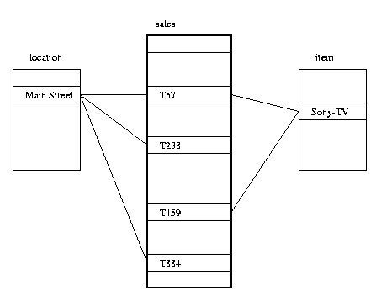
Indexing OLAP Data: Join Indices
Join index: JI(R-id, S-id) where R (R-id, …)  S (S-id, …)
Traditional indices map the values to a list of record ids
It materializes relational join in JI file and speeds up relational join
In data warehouses, join index relates the values of the dimensions of a star schema to rows in the fact table.
E.g. fact table: Sales and two dimensions city and product
A join index on city maintains for each distinct city a list of R-IDs of the tuples recording the Sales in the city
Join indices can span multiple dimensions

Slide 58
Data Warehouse Back end Tools
Data Cleaning
The data warehouse involves large volumes of data from multiple sources, which can lead to a high probability of errors and anomalies in the data. Inconsistent field lengths, inconsistent descriptions, inconsistent value assignments, missing entries and violation of integrity constraints are some of the examples.
The three classes of data cleaning tools are popularly used to help detect data anomalies and correct them:
Data migration tools allow simple transformation rules to be specified.
Data scrubbing tools use domain-specific knowledge to do the scrubbing of data. Tools such as Integrity fall in this category.
Data auditing tools make it possible to discover rules and relationships by scanning data. Thus, such tools may be considered variants of data mining tools.

Slide 59
Data Warehouse Back end Tools
Load
After extracting, cleaning, and transforming, data will be loaded into the data warehouse.
A load utility has to allow the system administrator to monitor status, to cancel, suspend and resume a load, and to restart after failure with no loss of data integrity.
Sequential loads can take a very long time to complete especially when it deals with terabytes of data.
Therefore, pipelined and partitioned parallelism are typically used. Also incremental loading over full load is more popularly used with most commercial utilities since it reduces the volume of data that has to be incorporated into the data warehouse.

Slide 60
Data Warehouse Back end Tools
Refresh
Refreshing a warehouse consists in propagating updates on source data to correspondingly update the base data and derived data stored in the warehouse.
There are two sets of issues to consider: when to refresh, and how to refresh. Usually, the warehouse is refreshed periodically (e.g., daily or weekly).
Only if some OLAP queries need current data, it is necessary to propagate every update.
The refresh policy is set by the warehouse administrator, depending on user needs and may be different for different sources.

Slide 61
Data Warehouse Back end Tools
Refresh techniques may also depend on the characteristics of the source and the capabilities of the database servers.
Extracting an entire source file or database is usually too expensive, but may be the only choice for legacy data sources.
Most contemporary database systems provide replication servers that support incremental techniques for propagating updates from a primary database to one or more replicas.
Such replication servers can be used to incrementally refresh a warehouse when the sources change.

Slide 62
Data Warehouse Tuning
The process of applying different strategies in performing different operations of data warehouse such that performance measures will enhance is called data warehousing tuning.
For this, it is very important to have a complete knowledge of data warehouse.
We can tune the different aspects of a data warehouse such as performance, data load, queries, etc.
A data warehouse keeps evolving and it is unpredictable what query the user is going to post in the future.
Therefore it becomes more difficult to tune a data warehouse system.

Slide 63
Data Warehouse Tuning…
Tuning a data warehouse is a difficult procedure due to following reasons:
Data warehouse is dynamic; it never remains constant.
It is very difficult to predict what query the user is going to post in the future.
Business requirements change with time.
Users and their profiles keep changing.
The user can switch from one group to another.
The data load on the warehouse also changes with time.

Slide 64
Data Warehouse - Testing
Testing is very important for data warehouse systems to make them work correctly and efficiently.
There are three basic levels of testing performed on a data warehouse:
Unit testing
Integration testing
System testing

Slide 65
Data Warehouse – Testing…
Unit Testing
In unit testing, each component is separately tested.
Each module, i.e., procedure, program, SQL Script, Unix shell is tested.
This test is performed by the developer.
Integration Testing
In integration testing, the various modules of the application are brought together and then tested against the number of inputs.
It is performed to test whether the various components do well after integration.

Slide 66
Data Warehouse – Testing…
System Testing
In system testing, the whole data warehouse application is tested together.
The purpose of system testing is to check whether the entire system works correctly together or not.
System testing is performed by the testing team.
Since the size of the whole data warehouse is very large, it is usually possible to perform minimal system testing before the test plan can be enacted.

